Slide 1
How we can be a
Company Logo
site better
Where to find engineering and indirect supply chain efficiencies and savings for our business.

Slide 2
Where we must improve
COSTS
PRODUCTIVITY
EFFICIENCY
DOWNTIME
£££

Slide 3
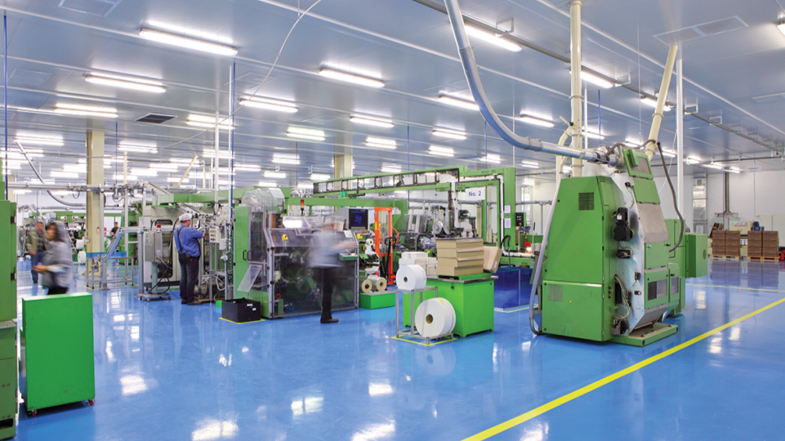
How we must look to improve
Enhance our purchasing effectiveness
Increase our productivity
Maximise our efficiency
Minimise our downtime

Slide 4
What we need to be…
Better quality
Faster
better value
flexible
more responsive

Slide 5
Where to start?
Maximised efficiency
best people, best process, best practice
For decreased downtime
it’s not just about maintenance
For increased productivity
continuous improvement and innovation
For reduced costs
levering value from the supply chain

Slide 6
How much could we save?
Costs 10% of budget spent on unnecessarily duplicated parts
Productivity 13 minutes wasted, searching for every replacement part
Efficiency 10-50% of engineers’ time wasted on non-core tasks
Downtime 15% caused by lack of the right spare parts

Slide 7
How can we save?
PRODUCTIVITY
Be better organised Reduce time taken to find replacement parts, improve our processes/systems
COSTS
Carefully manage inventory Reduce duplicate purchasing, reduce our stock, rationalise the number of vendors
Better manage our stock Ensure parts availability for quicker repairs, align stock with production needs, introduce consignment stock, link the stores with engineering need
SERVICES
DOWNTIME
Be more efficient at procurement Leave engineers free to concentrate on improving productivity
EFFICIENCY

Slide 8
Finding the answers – start simple
Know what’s critical: Identify and label our critical parts to reduce risk
Know what’s where: Cleanse our data and manage it
Essential parts where we need them: Lineside vending or storage for fast moving consumables
Make supply simpler: Consolidate our vendors to leverage efficiencies
Exploit technical expertise: Utilise supplier know-how for the latest solutions

Slide 9
Benefits of outsourcing
Freedom to focus on core tasks and skills
Sustainable cost savings – Total Cost of Ownership
Time saved on procurement % spares management
Reduced downtime
Simplified supply chain
Maximised process efficiency
Greater stock control
Greater budget visibility and accountability
Minimising downtime and maximising profit plant-wide

Slide 10
From cost centre to profit centre
Benefits of outsourcing
An experienced on-site supply partner will:
Allow our engineers to concentrate on engineering
Introduce new/alternative technologies based on TCO
Allow purchasing to concentrate on strategic ‘core’ areas
Deliver best practice in our indirect supply and parts solution
Drive inefficiencies from our supply chain
Turn maintenance from a cost to a revenue driver
Turn our stores from a cost centre to a profit centre
Help us realise benefits throughout our organisation
Provide an important competitive advantage

Slide 11
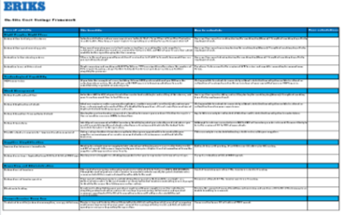
Savings - delivered
Add in your own business savings, using our easy to calculate, cost savings framework: Click here to download

Slide 12
Next steps to success
STEP 1
DAY 1: APPROVAL
from key stakeholders in business to embark on process
STEP 2
DAY 1+1: ENGAGEMENT
with chosen partner for detailed review
STEP 3
DAY 1+14: EVALUATION
of real savings with supply partner
STEP 4
DAY 1+21: REPORT
on potential savings and recommendations for ways forward

Slide 13
Why ERIKS on-site solutions?
UK’s leading provider
Currently managing 125+ sites in the UK and Ireland
Unique market position:
Add value through technical know-how
Supply / advise
Source / procure
Product and application expertise
Repair / replace
Manage MRO stores and inventory
Process improvement and re-engineering

Slide 14
Outsourcing success story 1
STORES REDEVELOPMENT
Leading drinks manufacturer
Untidy, disorganised stores
Poorly labelled and poorly segregated parts
ERIKS’ SOLUTION
Unique bin location for each item
Logical, consistent location hierarchy
Barcoded item labelling
Aisle, bay and shelf labelling and signage
Well-organised, efficient stores, achieved in existing stores’ footprint, with minimum disruption
SERVICES
RESULT

Slide 15
Outsourcing success story 2
SUPPLY CHAIN AND STORES OVERHAUL
Global manufacturer of analytical instruments, laboratory equipment etc.
Large, growing supply chain stores requiring consolidation
ERIKS’ SOLUTION
Dedicated MRO engineering stores
Lineside consumables vending
Web-based stores management (ERIKS Easy Order System)
Rationalised supplier base with 24/7 MRO contract
Reduced Total Cost of Ownership
Potential for increased plant and process efficiency
SERVICES
RESULT

Slide 16
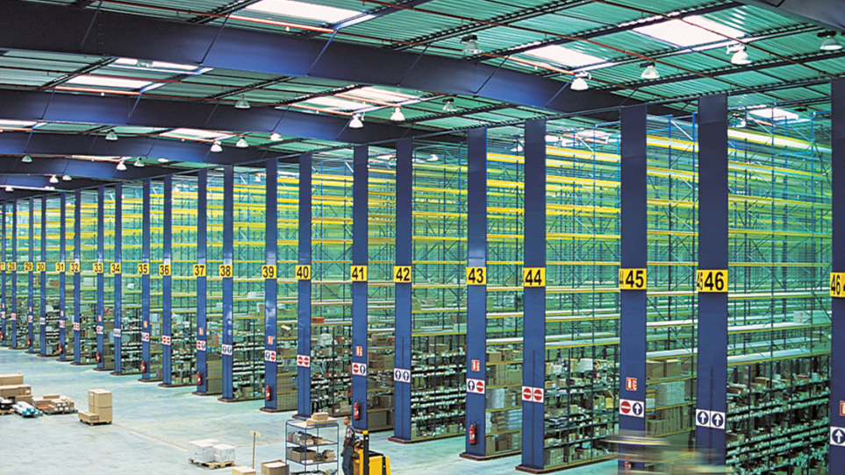
Outsourcing success story 3
STORES RELOCATION AND IMPROVEMENT
World leader in design/manufacture of subsea systems
Relocating stores from 3 floors to new single floor site
Implementation of new inventory management systeM
ERIKS’ SOLUTION
Design and install complete storage solution, optimising available space
Relocate stores over 5-month period
Create operator Instruction Manual for inventory system
Previously hidden stores are now an essential stop on-site tours for blue chip customers
SERVICES
RESULT

Slide 17
Where we could save
Stock reduction and rationalisation
Supplier leverage
Manufacturer rationalisation
Energy consumption
Reverse engineering OEM parts
Warranty issues
Repair v Replace
Administration processes
Online trading platform

Slide 18
How we can be a
Company Logo
site better

